Slide 1

intelligent traffic light control system
Subject Name:
DATA STRUCTURES AND ALGORITHMS,OBJECT ORIENTED PROGRAMMING SYSTEM IN JAVA
By Group-14:
Sreeshanth (CB.SC.U4AIE24225)
Sai Vandith (CB.SC.U4AIE24239)
Reshwanth (CB.SC.U4AIE24246)
Kaushik Ram (CB.SC.U4AIE24266)
Subject Code:
22AIE112
22AIE111

Slide 2
Introduction:
Traffic congestion is a major issue in urban areas which leads to increase in travel time ,fuel consumption , and mainly the pollution
Traditional traffic light systems operate on fixed timers, which do not adapt to real-time traffic condition
An Intelligent Traffic Light Control System that dynamically adjusts green light durations based on vehicle density
The system processes traffic data from different directions (North, South, East, and West). The algorithm prioritizes directions with higher vehicle counts, ensuring a fair and efficient allocation of green light time

Slide 3
The system takes input from the dataset containing traffic data. When the user enters a row number, the program automatically retrieves the traffic data for that instance and calculates the optimal green light timings
Roads(Direction) with more vehicles receive longer green signals, while roads with fewer vehicles get shorter ones, ensuring a smooth and fair traffic flow.

Slide 4
Objective:
Adjusts green light duration based on real-time traffic flow.
Reduce waiting time by prioritizing congested roads
Minimize traffic jams by using smart signal adjustments instead of fixed cycle times

Slide 5
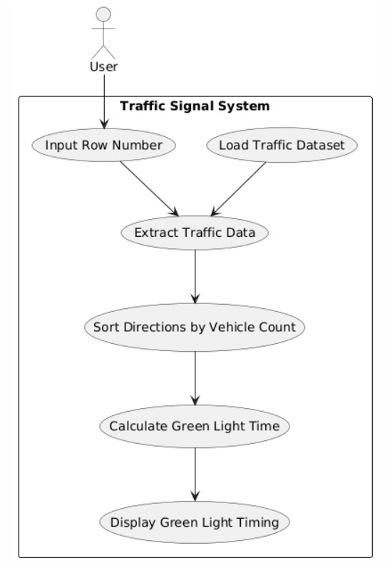
UML Diagram:

Slide 6
Involvement of DSA:
Sorting :
Sorting the vehicle counts to the determine priority order (Tim sort using the O(nlogn )) and bubble sort( O(n2))
Arrays :
An Array is a collection of elements stored in a specific order , It allows easy storage, access
We used an array to store and sort traffic data in descending order based on vehicle count
Hash Map :
A hash map (dictionary) stores data in key-value pairs, and allows fast access in O(1) time
In our project, keys are directions ("North", "South", etc.), and values are vehicle counts

Slide 7
Implementation of OOP Concept:
Class and Object :
We created the Intelligent Traffic Light class to manage traffic data
we created an object traffic-system using the class
Constructor :
The “init” method is a constructor that runs automatically when we create an object
It initializes the object and loads traffic data from the CSV file
Inheritance:
FixedTimerTrafficLight is the parent class where a fixed green light timer of 30 seconds is provided for all directions. In this class, the dataset is loaded using the file path passed to the constructor. On the other hand, IntelligentTrafficLight is the child class that inherits from the parent
A super keyword is used to call the parent class constructor, which means the dataset loaded in the parent class is automatically available in the child class.

Slide 8
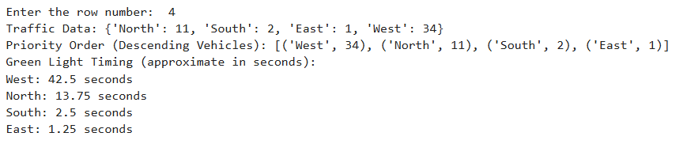
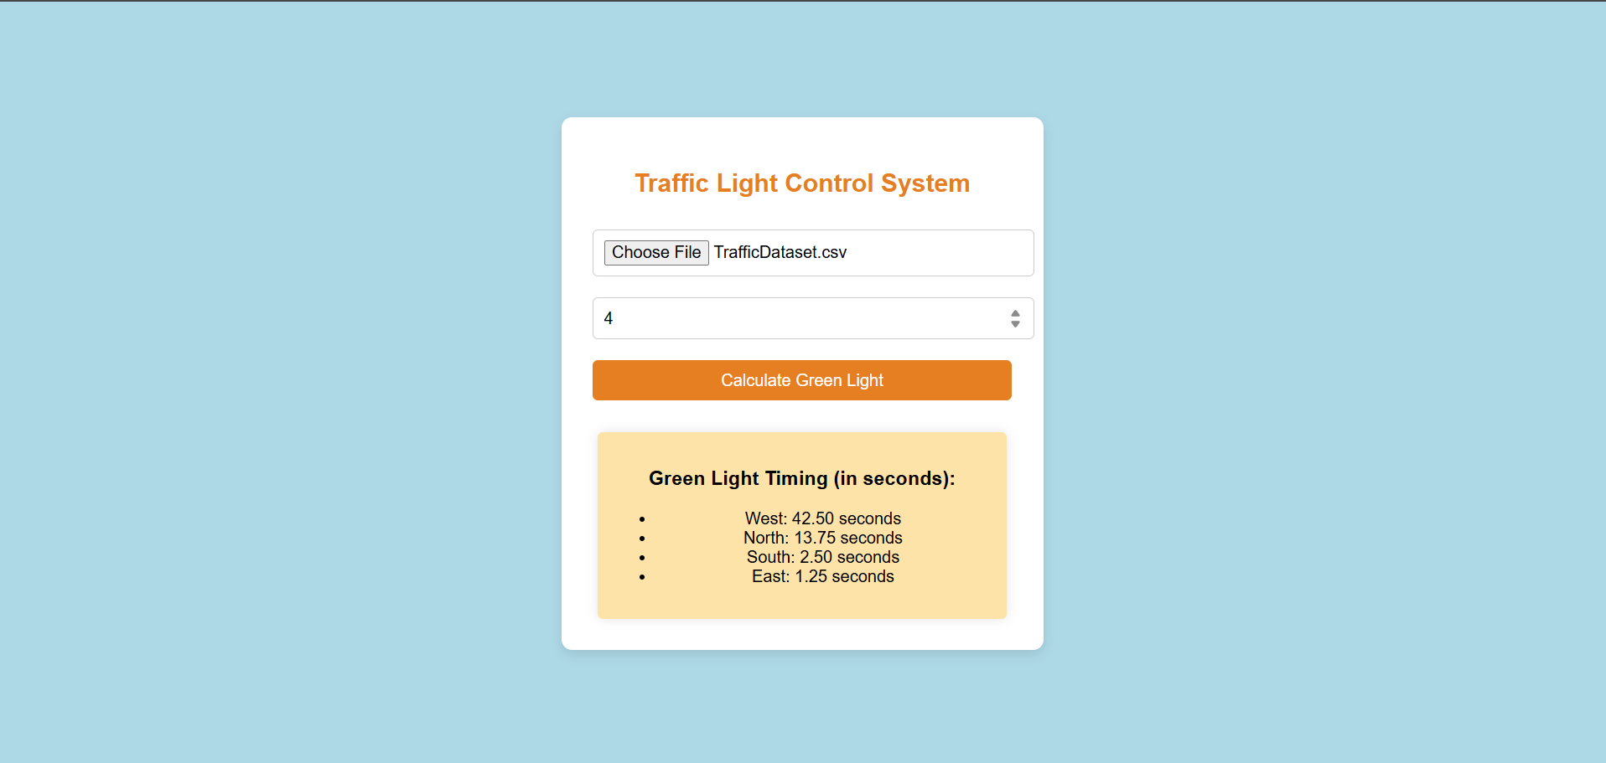
Results:
Python Code Results
UI Page Results

